Slide 1
Sexual Diversity in Nature
Module 2: Science and Identities

Slide 2
Pre-Class Work
Fill out KWL Chart (Leave the L Blank)
Read assigned animal sex determination article
Consider the guiding questions

Slide 3
Think/Pair/Share Class KWL Chart
Sex Determination
(K) | (W) | (L)
What do you already know about how sex is determined in animals? | What do you want to know about sex determination? What do you wonder? | What have you learned about sex determination?

Slide 4
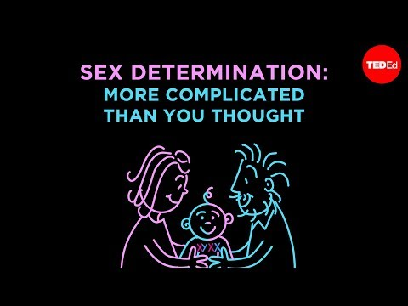
Sex Determination in Nature Review
(YouTube/TedEd/Reedy, 2012)
Notes:
Citation: (Reedy A. 2012. Sex Determination: More Complicated Than You Thought. TedEd. YouTube) https://www.youtube.com/watch?v=kMWxuF9YW38

Slide 5
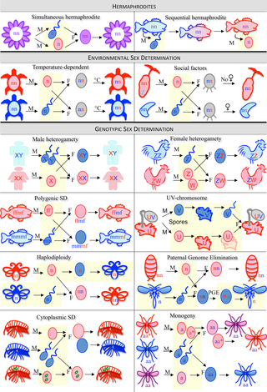
Sex Determination in Nature Review
(Bachtrog, et.al, 2014)
Sex can be determined in a variety of ways across the animal kingdom
Notes:
Citation: Bachtrog D, Mank JE, Pecihel CL, Kirkpatrick M, Otto SP, Ashman TL, Hahn MW, Kitano J, Mayrose I, Ming R, Perrin N, Ross L, Valenzuela N, Vamosi JC. 2014. Sex Determination: Why So Many Ways of Doing It? PLoS Biol 12(7): e1001899. https://doi.org/10.1371/journal.pbio.1001899

Slide 6
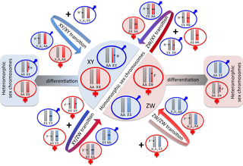
Sex Determination in Nature Review
(Bachtrog, et.al, 2014)
Chromosomes that determine sex can change over time
New sex-determining genes can lead to transitions in sex
Notes:
Citation: Bachtrog D, Mank JE, Pecihel CL, Kirkpatrick M, Otto SP, Ashman TL, Hahn MW, Kitano J, Mayrose I, Ming R, Perrin N, Ross L, Valenzuela N, Vamosi JC. 2014. Sex Determination: Why So Many Ways of Doing It? PLoS Biol 12(7): e1001899. https://doi.org/10.1371/journal.pbio.1001899

Slide 7
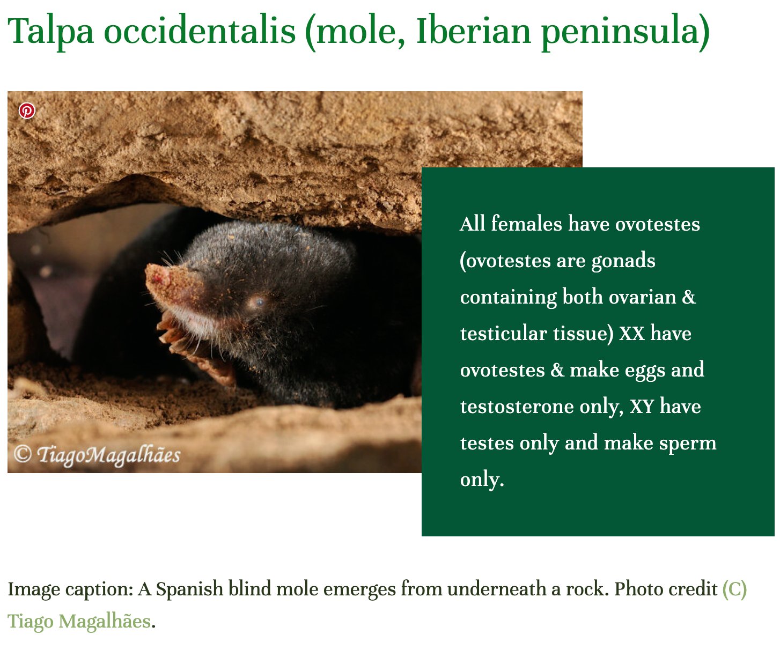
Diverse Sexes!
(Gender Inclusive Biology, 2020)
Notes:
Citation: Gender Inclusive Biology. 2020. All XX Spanish Moles Have Ovotestes (Both Ovarian & Testicular Tissue) And Make Eggs & Testosterone, But XY Moles Only Have Testes & Make Sperm. (Gender Showcase, 9-12).
https://www.genderinclusivebiology.com/newsletter/ewpj1t6hd3kl0fgubs2g08ad7y1pz2

Slide 8
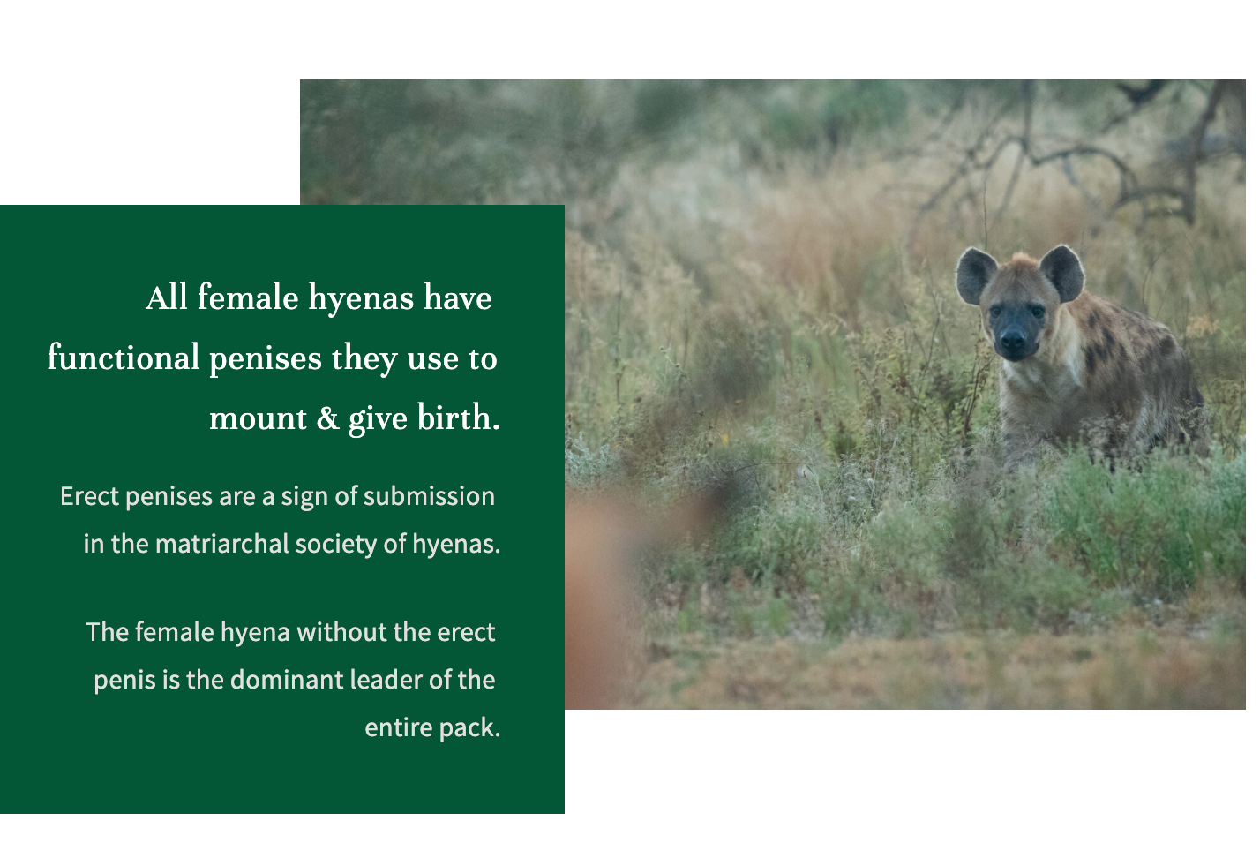
Diverse Sexes!
(Gender Inclusive Biology, 2020)
Notes:
Citation: Gender Inclusive Biology. 2020. All Female Spotted Hyenas Have Penises They Use To Mount, Pee, & Give Birth. (Gender Showcase, 9-12)
https://www.genderinclusivebiology.com/newsletter/all-female-spotted-hyenas-have-functional-penises-and-mount-both-male-amp-female-hyenas-gender-showcase-9-12

Slide 9
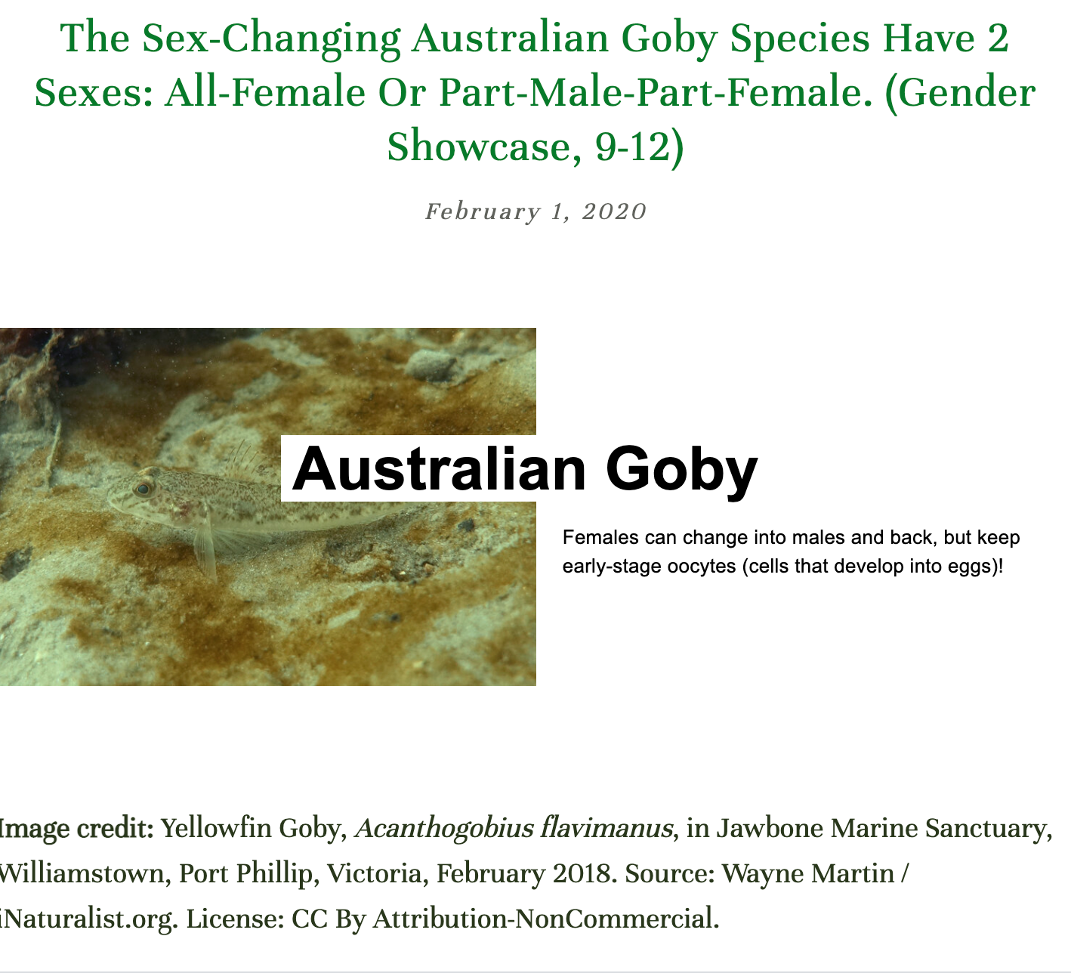
Diverse Sexes!
(Gender Inclusive Biology, 2020)
Notes:
Citation: Gender Inclusive Biology. 2020. The Sex-Changing Australian Goby Species Have 2 Sexes: All-Female Or Part-Male-Part-Female. (Gender Showcase, 9-12)
https://www.genderinclusivebiology.com/newsletter/australian-gobys-have-2-genders-all-female-or-part-male-part-female-gender-showcase-9-12

Slide 10
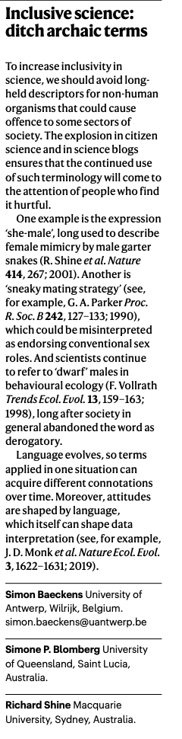

Nature: Inclusive Science
Read the Nature correspondence 'Inclusive Science: Ditch Insensitive Terminology'
(Baeckens, Blomberg, Shine, 2020)
Notes:
Citation: Baeckens S, Blomberg SP, Shine R. 2020. Inclusive science: ditch archaic terms. Nature. 580:185

Slide 11
Class KWL Chart
Sex Determination
(K) | (W) | (L)
What do you already know about how sex is determined in animals? | What do you want to know about sex determination? What do you wonder? | What have you learned about sex determination?

Slide 12
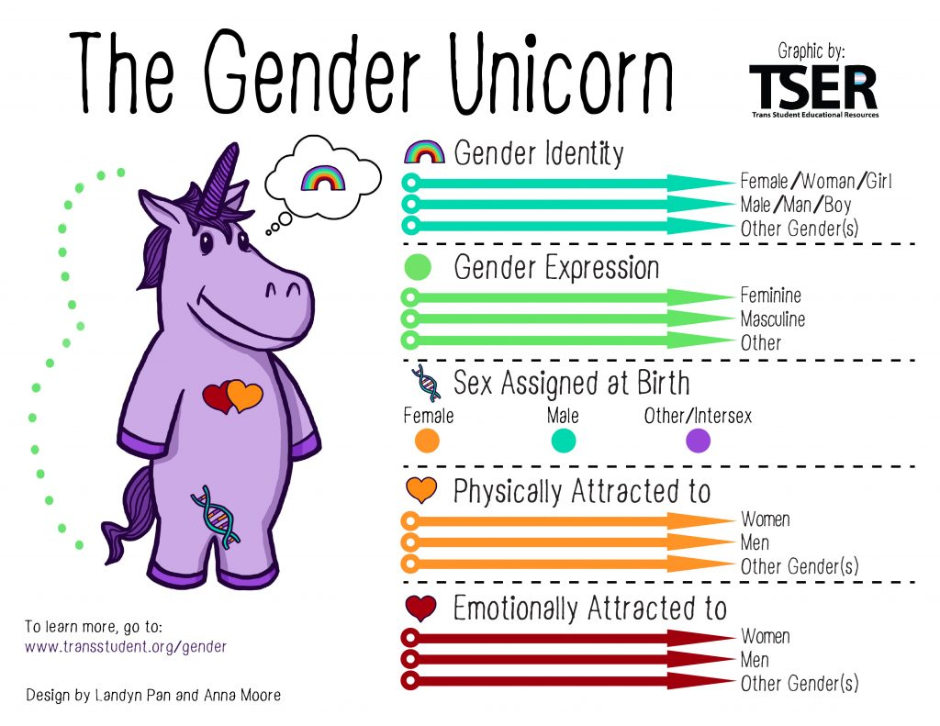
Terminology
Cisnormativity- social norms where cis-gender identities are considered 'normal' and systems privilege cis identities.
Biological Binary Essentialism- the belief that biological sex is a binary (male or female) and permanent.

Slide 13
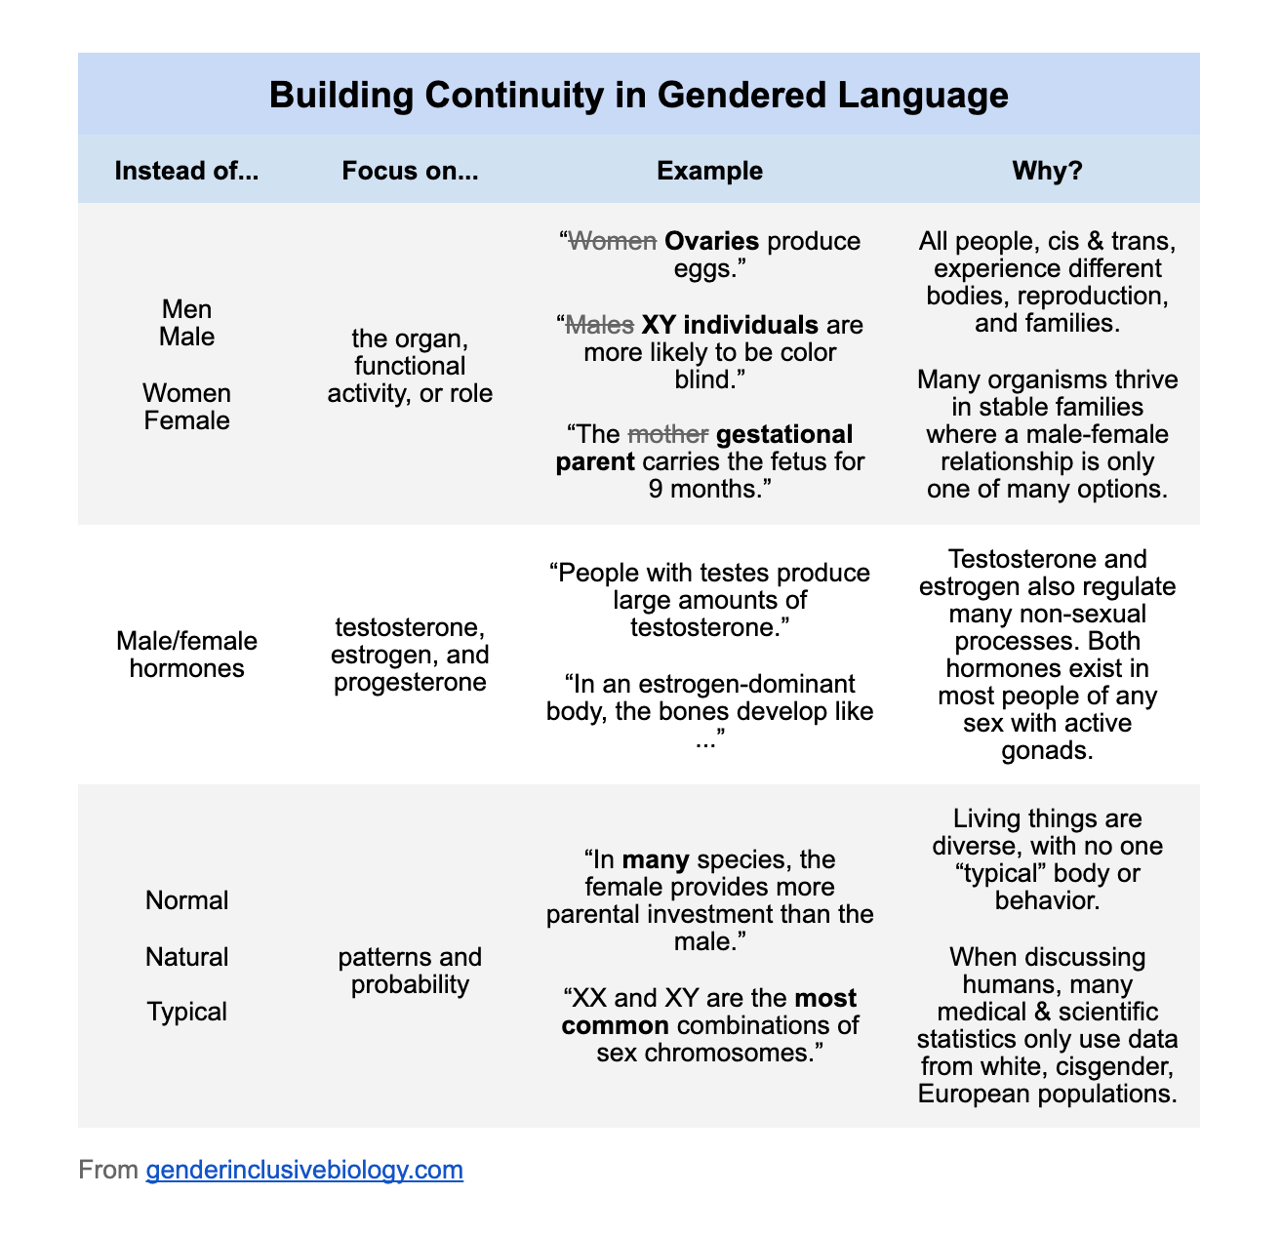
Terminology

Slide 14
Discussion
How do the societal norms of cisnormativity and biological binary essentialism impact science?
How can/does science impact these societal norms?

Slide 15
Conclusions
Simplification of sexual biology
Binary sex essentialism
Binary societal beliefs of sex
In the natural world, sex isn't binary and is determined by a variety of ways (chromosomes, temperature, environment, hormones, etc.)
Humans categorizing and assigning sex in nature is culturally situated by our societal values (Ex. Cisnormativity and Biological Binary Essentialism is applied on to our understanding of the natural world)

Slide 16
Assessment

